Slide 1
Erasmus+ Ka2 CBHE BESTSDI Project
Event: NatRisk, Interproject coaching meetings
Date: 7th to 8th March 2018
Datum: 05.03.2018.
Prof.dr Emina Hadžić

Slide 2
BESTSDI objectives
The wider objectives of the BESTSDI project is to improve the quality of higher education in Geographical Science and Technology field, SDI and geodesy, enhance its relevance for the labour market and society and to improve the level of competences and skills in HEI's by
developing new and innovative education programmes within the field of SDI. These wider objectives are fully compliant with the priorities of the Capacity Building projects within the Erasmus+ program.

Slide 3
BESTSDI objectives
The specific project objectives are to develop, test and adapt new curricula, courses, learning material and tools within the field of SDI. In doing so, existing undergraduate and graduate geodesy and geoinformatics curricula’s in the academic institutions in the WB region will be lifter to higher levels, recognising the of spatial data for modern society and its development. By the incorporation of SDI concept and other modern concepts based on spatial data and information, the students of the new courses will have the ability to provide efficiently spatial data and services to SDI users.

Slide 4
BESTSDI objectives
In parallel, the project also introduces SDI and related concepts in undergraduate and graduate study programs on academic institutions which profiles are well recognized as SDI users, raising awareness among the students and professionals about the relevancy of SDI and advantages of well organized spatial data.

Slide 5
SDI concept
A Spatial Data Infrastructure (SDI) is a framework to share, discover and re-use spatial data among public authorities, the private sector and citizens. SDI’s are based on a “coordinated series of agreements on technology standards, institutional agreements, and policies” (Kuhn 2005) that unlock geospatial information resources for a wide range of application fields, for instance environmental monitoring and policy making, transportation planning, health care, physical planning, national security, etc.
They are an integral part of the e-government movement and open data initiatives.

Slide 6
SDI framework
INSPIRE is an EU Directive (2007/2/EC) aiming to establish an infrastructure for spatial information in Europe to support Community environmental policies and policies or activities which may have an impact on the environment (http://inspire.ec.europa.eu/). The Directive addresses problems regarding the availability, quality, organisation, accessibility and sharing of spatial information. INSPIRE may be seen as the legal framework of a European SDI.
SDI is introduced in national legislation of all EU countries
SDI is introduced also in national legislation of partner countries as:
Independent law (Albania, Macedonia)
Part of State Survey and Cadastre law (Kosovo, Serbia, Montenegro, Republic of Srpska – BiH)
Governmental Decree (Federation of Bosnia and Herzegovina – BiH)

Slide 7
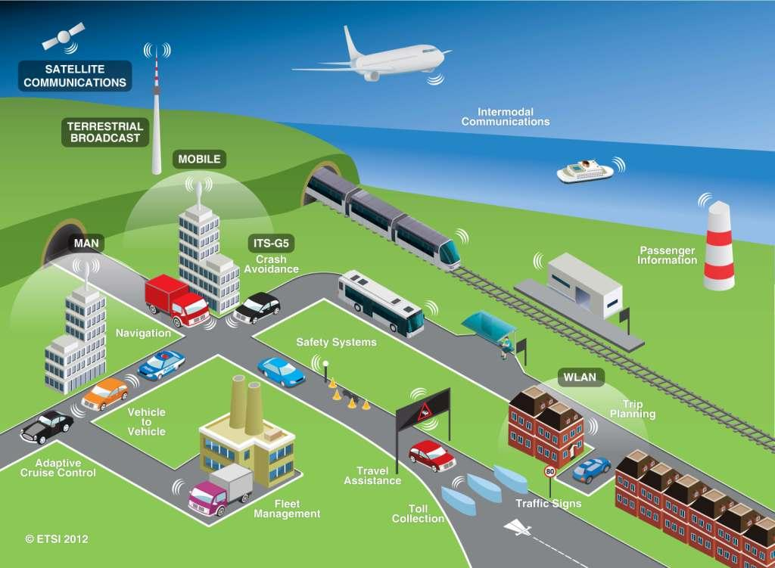
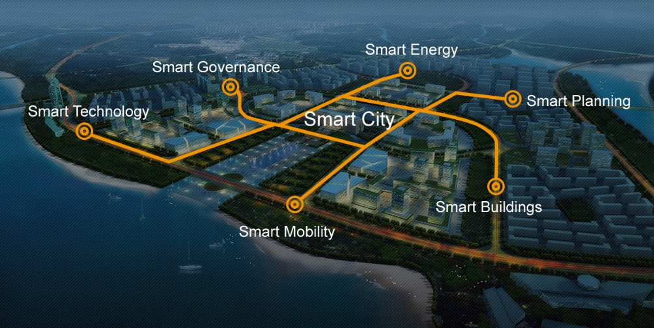
SDI is much more
Precise farming
Intelligent transportation
Smart environment
Smart cities

Slide 8
BESTSDI partners
Project coordinator:
Sveučilište u Zagrebu (University in Zagreb) – Croatia
Program countries:
Katholieke Universiteit Leuven (Catholic University of Leuven) – Belgium
Sveučilište u Splitu (University of Split) – Croatia
Univerzitet “Sv. Kiril i Metodij” Skopje (Ss. Cyril and Methodius University in Skopje) – Macedonia
Hochschule Bochum (Bochum University of Applied Sciences) – Germany

Slide 9
BESTSDI partners
Partner countries:
Universiteti Politekniki i Tiranës (Polytechnic University of Tirana) – Albania
Universiteti Bujqesor i Tiranes (Agricultural University of Tirana) – Albania
Univerzitet u Banjoj Luci (University of Banja Luka) – Bosnia and Herzegovina
Sveučilište u Mostaru (University of Mostar) – Bosnia and Herzegovina
Univerzitet u Sarajevu (University of Sarajevo) – Bosnia and Herzegovina

Slide 10
BESTSDI partners
Partner countries:
Javna Ustanova Univerzitet u Tuzli Universitas Studiorum Tuzla (University of Tuzla) – Bosnia and Herzegovina
Universiteti Nderkombetar per Biznes dhe Tehknologji UBT (University for Business and Technology – UBT) – Kosovo
Javna ustanova Univerzitet Crne Gore Podgorica (Unviersity of Montenegro) –Montenegro
Unvierzitet u Beogradu (University of Belgrade) – Serbia
Univerzitet u Novom Sadu (University of Novi Sad) – Serbia
Universiteti “Ukshin Hoti” ne Prizren (University of “Ukshin Hoti” in Prizren) – Kosovo

Slide 11
BESTSDI partners
Associated partners:
Republička uprava za geodetske i imovinsko-pravne poslove Republike Srpske (Republic Administration for Geodetic and Property Affairs of Republika Srpska) – Bosnia and Herzegovina
Federalna uprava za geodetske i imovinsko-pravne poslove Federacije Bosne i Hercegovine (Federal Administration for Geodetic and Property Affairs of Federation of Bosnia and Herzegovina) – Bosnia and Herzegovina
Agencija na katastar na nedvižnosti (Agency for Real Estate Cadastre) –Macedonia

Slide 12
BESTSDI partners
Subcontractors:
Lantmäteriet (Swedish National Mapping and Cadastre Authority) – Sweden
Novogit AB – Sweden

Slide 13
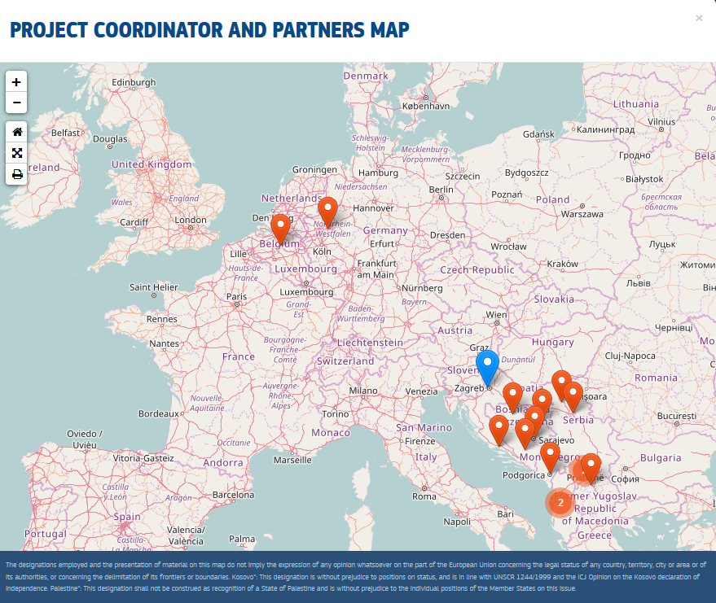
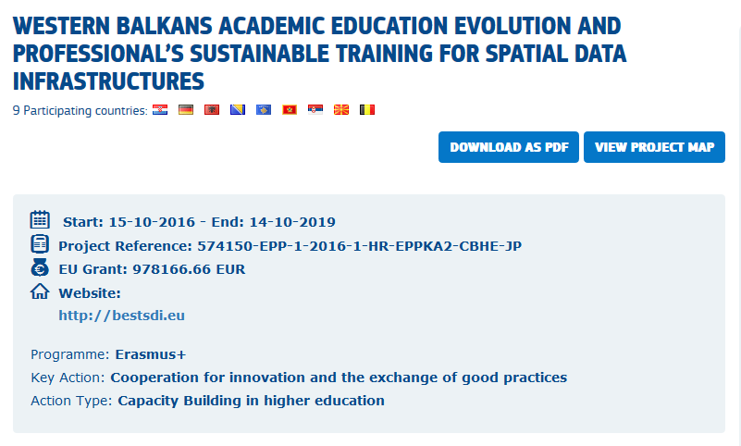
http://ec.europa.eu/

Slide 14
BESTSDI project activities
Work packages:
WP1 – Preparation – Specification of the core curriculum
WP2a – Development – Development of curriculum
WP2b – Development – Implementation f curriculum
WP3 – Quality Plan
WP4 – Dissemination & Expoitation
WP5 - Management

Slide 15
WP1 - Preparation
WP2a – Development of curriculum
1.1 – Current curriculum status
1.2 – Current learning material status
1.3 – Requirements analysis
1.4 – Specification of project curriculum
1.5 – Curriculum adaptation specification
2.1 – Development of project curriculum
2.2 – Development of LLL courses for professionals
2.3 – Equipment purchase/installation
2.4 – Training of teachers
2.5 – Localisation of curriculum

Slide 16
WP3 – Quality Plan
WP2b – Implementation of curriculum
3.1 – Development of Quality Assurance Plan
3.2 – Evaluation of progress & results
3.3 - Monitoring success indicators
2.6 – Implementation of local curriculum
2.7 – Running the courses to students
2.8 – Evaluation of implementation
2.9 – Revision of project curriculum

Slide 17
WP4 – Dissemination & Exploitation
WP5 - Management
4.1 – Development of a Communication Plan
4.2 – Life-long learning (LLL) courses for professionals
4.3 – Production of dissemination material
4.4. – Development Plan for Dissemination and Exploitation of Results (DER)
4.5. – Dissemination and exploitation execution
5.1 – Project Office and Management Structure
5.2 – Project Coordination, Administration and Monitoring
5.3 – National Stakeholder Coordination

Slide 18
BESTSDI expected results
To develop appropriate curricula, courses and their content for both target groups (SDI providers and SDI users) of academic institutions. This includes the development of:
SDI compulsory course for undergraduate study programs in geodesy
SDI modules for graduate study programs in geodesy and geoinformatics
SDI user course components (not necessary full courses) for undergraduate study programs of partner faculties
SDI elective courses for graduate study program of partner faculties (SDI users)
Development of sustainable training courses (life-long education) of broad scope of professionals

Slide 19
BESTSDI expected results
To disseminate the project experiences and results in order to create additional value and multiply the impact of the results. As a consequence, dissemination will be made about best practices in teaching on SDI, the content of the developed courses, experience in introduction of newly developed courses and training courses for professionals to professional society. Theses dissemination activities are made to targeted audience like professional bodies, public authorities etc.
To establish the necessary foundation for the participation of partner universities in the academic SDI arena.
To provide equipment for implementation of modernized curricula to partner universities so that new kind of professionals will be equiped with broade cognition, knowledge and skills about SDI and other modern spatial data related concepts will be result of education process in involved institutions.

Slide 20
BESTSDI additional benefits
New level of communication and cooperation among the partner universities with the emphasis on SDI but expanding it on institutional and project cooperation.
Exchange of students and staff will be fostered through the project activities and information about activities conducted by the partners communicated among the partner universities (like International Doctoral Seminar in Dubrovnik starting in 2017)

Slide 21
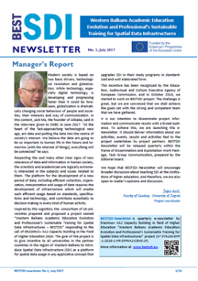
BESTSDI Social networks
bestsdi.eu Official web site of BESTSDI project funded by the European Union under ERASMUS+ KA2 Capacity Building in Higher Education.
BESTSDI NEWSLETTER:
Bestsdi INFO
Bestsdi news

Slide 22
Thank you for your attention!
www.bestsdi.eu
info@bestsdi.eu
----
This project has been funded with support from the European Commission. This presentation reflects the views only of the author, and the Commission cannot be held responsible for any use which may be made of the information contained therein.

